Slide 1
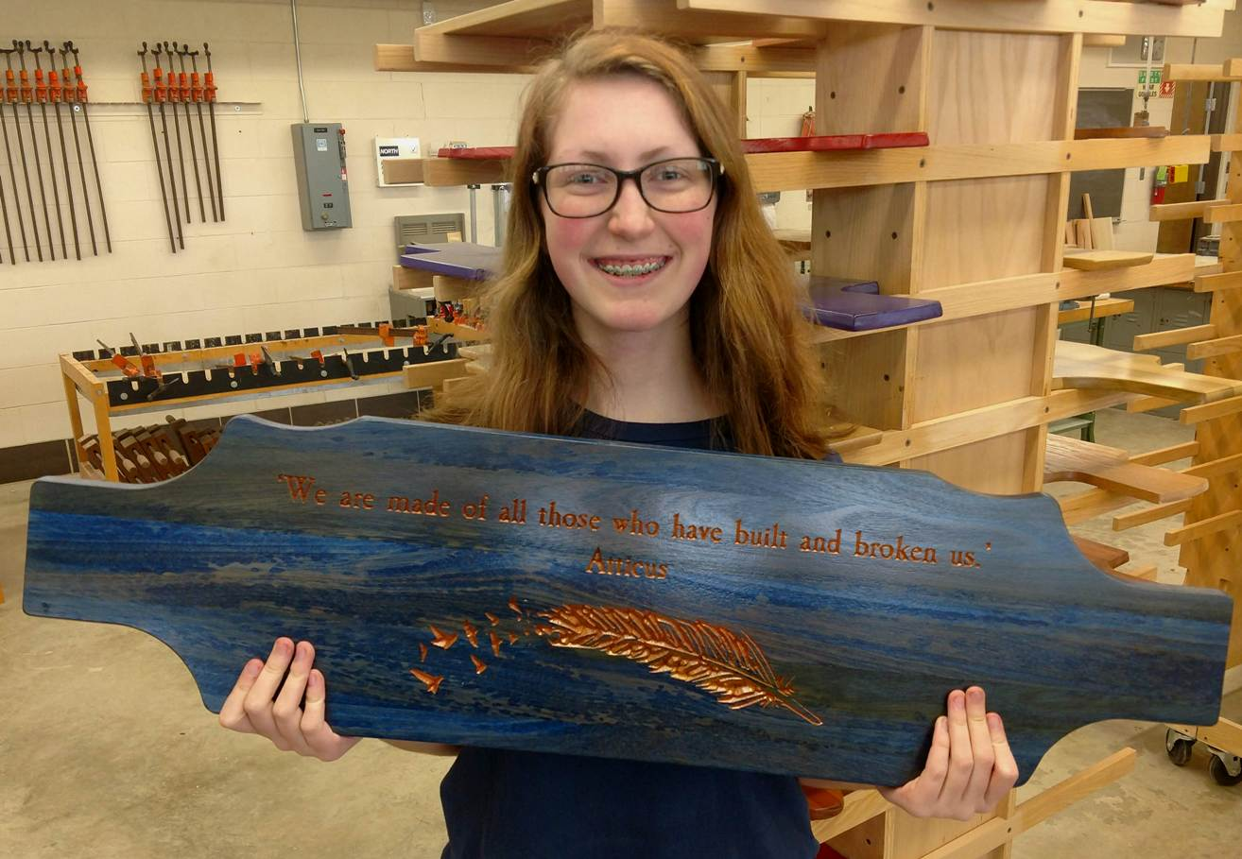
Marketing Your Program-How to Get Started
College of Woodworking Knowledge-Teacher Track 42
AWFS Fair, July 17-20, 2019 Las Vegas, Nevada
Presenter: Mark Smith
Industrial Technology Instructor-Reed Custer High School
Adjunct CAD Instructor-Joliet Junior College
Adjunct CAD Instructor-Waubonsee Community College
Education Committee Member-Woodwork Career Alliance on North America

Slide 2
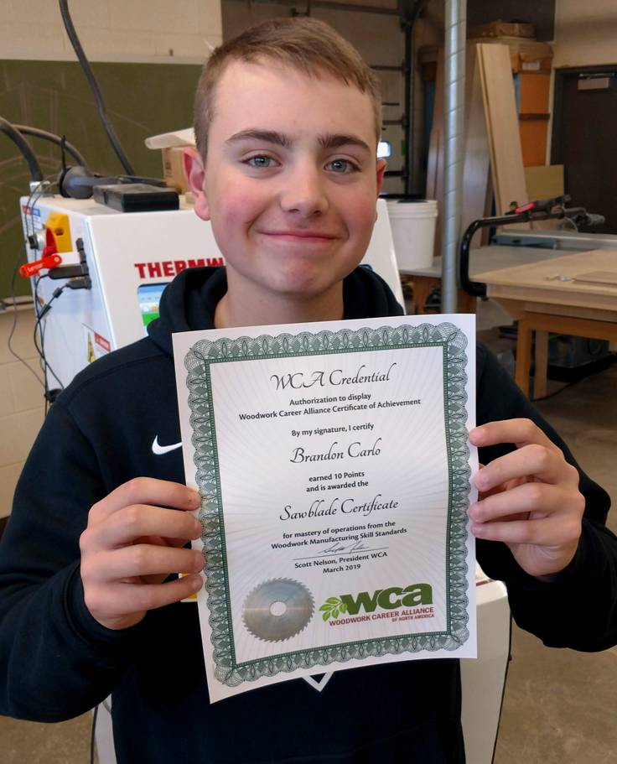
Creating Marketing Tools For Your Program
Why should I create marketing tool for my program?
Develop Program Supporters
Cultivate Industry Partners
Generate Student Internship Opportunities
Student career opportunities
Foster Student Tech Support-Inside & Outside
Generate Field Trip Opportunities (Virtual)
Develop Government Relationships
Produce Program Recognition
Create Revenue Streams-Sun Glasses, Cabinet Jobs
Leverage Celebrity Recognition-Jimmy Stafford (Train)
Assist with Student Recruitment
Influence with School Administration

Slide 3
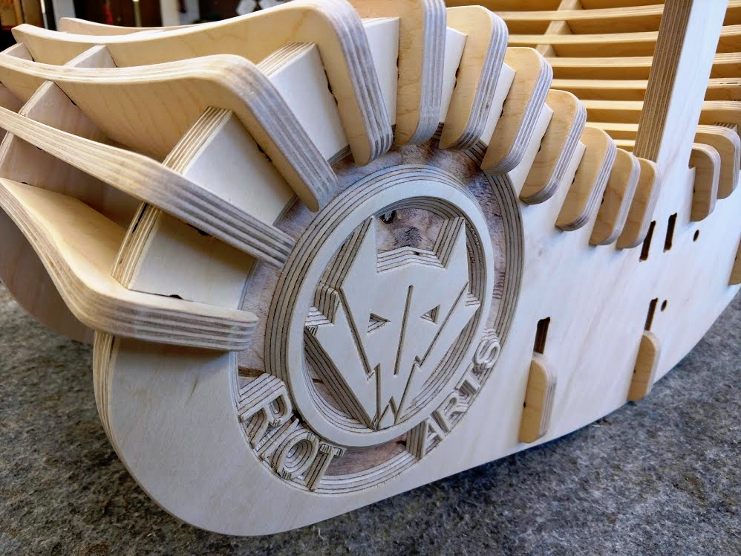
Free Marketing Tools-What free tools can I use?
Smart Phone
YouTube.com
FaceBook.com
Instagram.com
LinkedIn.com
Box.com
Dropbox.com
Website
Newsletter
Thank You Video
Electronic Portfolio
Press Kit
Thank You Cert. Template
Program Brochure
Open House Program
Industry led Award Ceremony
Letters of Commendation

Slide 4
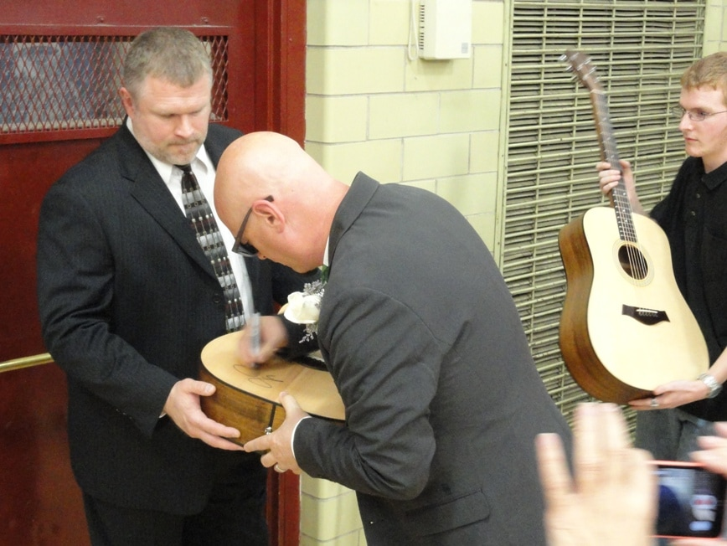
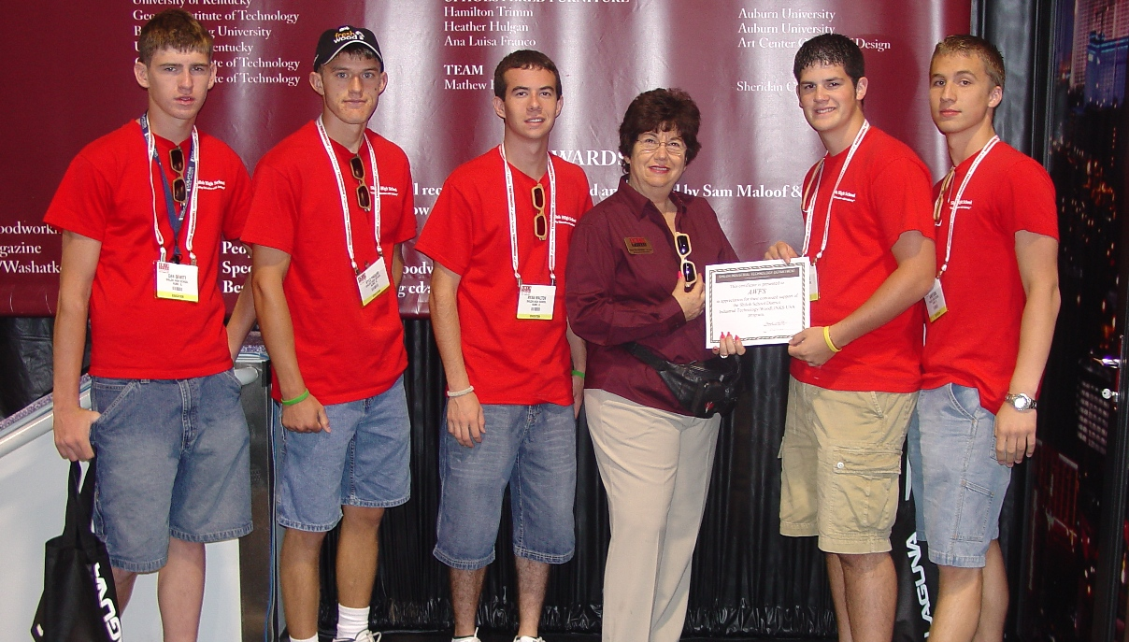
Free Marketing Tools-Pictures
Smart Phone
Almost everyone has one
Digital Camera-better pictures
Student Volunteer-tech savvy

Slide 5
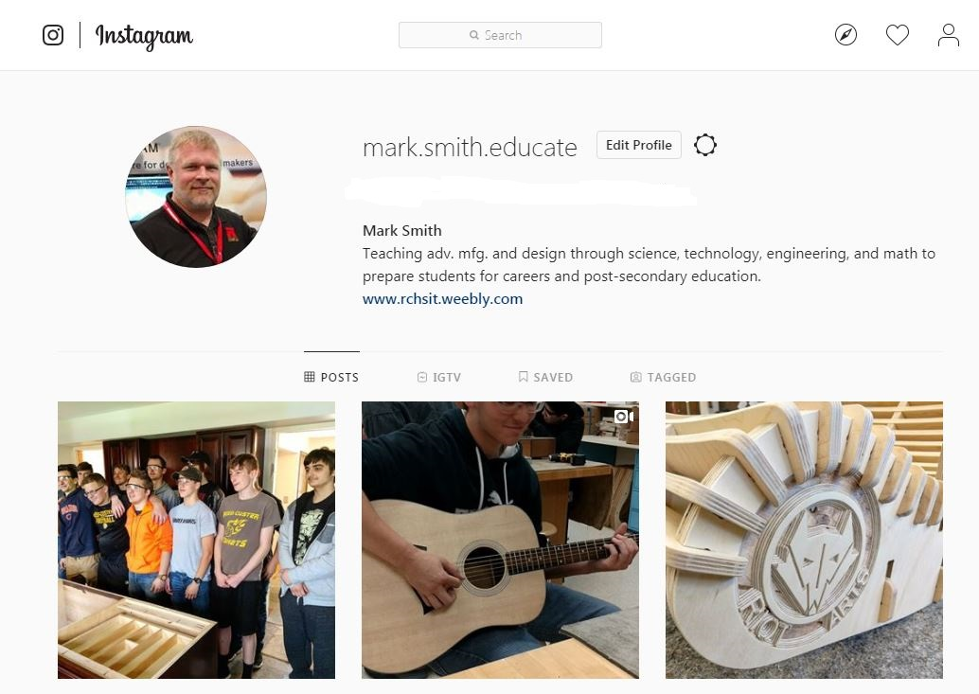
Free Marketing Tools-Instagram

Slide 6
Free Marketing Tools-YouTube

Slide 7
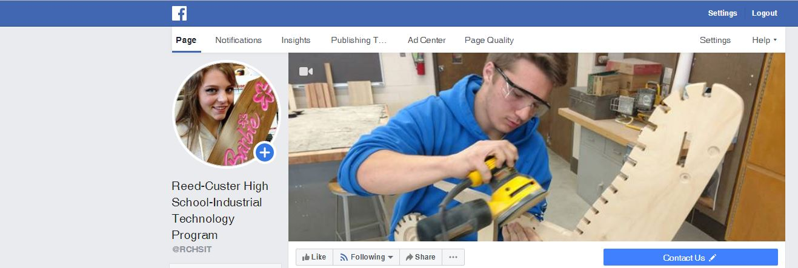
Free Marketing Tools-FaceBook

Slide 8
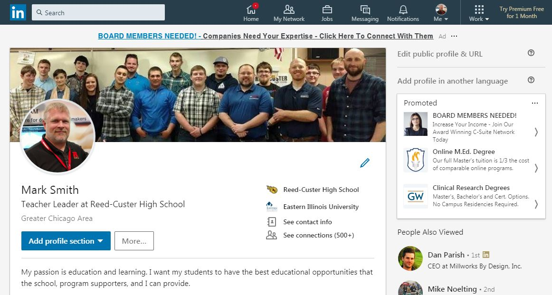
Free Marketing Tools-LinkedIn

Slide 9
Free Marketing Tools-Box.com

Slide 10
Free Marketing Tools-Dropbox.com

Slide 11
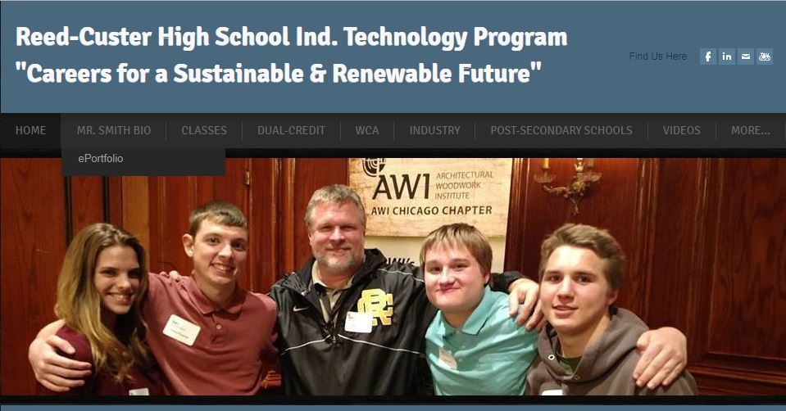
Free Marketing Tools-Web Site
Weebly.com
Wordpress.com
Web.com
eHost.com
Site123.com
Bigcommerce.com
Deluxe.com
Hibu.com
Websitebuilder.com
Doodlekit.com
Networksolutions.com
Eebnode.com Online presences is a must today!
Wix.com

Slide 12
Free Marketing Tools-Video
Tools-Thank You Video
Field Trips
Equipment Donations
Tech Support
Supply Donations
Teacher/Student Training
Articles about Program
Visits from Industry
Visits from Politicians
Visits from Industry Partners
Industry Presentations
Industry Trade Shows

Slide 13
Free Marketing Tools-Newsletter

Slide 14
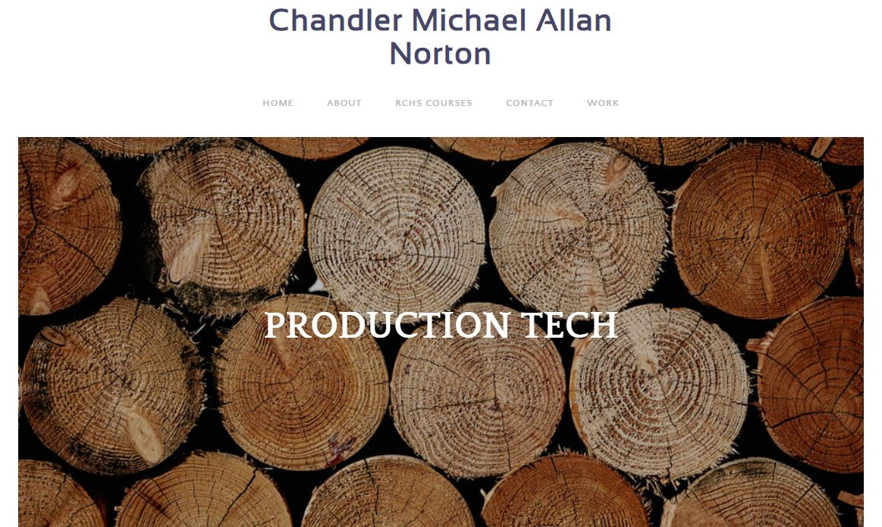
Free Marketing Tools-Electronic Portfolio

Slide 15
Free Marketing Tools-Appreciation Certificate
Who should I be thanking?
Board Members
Administrators
School Secretaries
Program Supporters
Parents
Media
Community Colleges
Industry Partners
Students
Politicians/Government
Anyone and Everyone

Slide 16
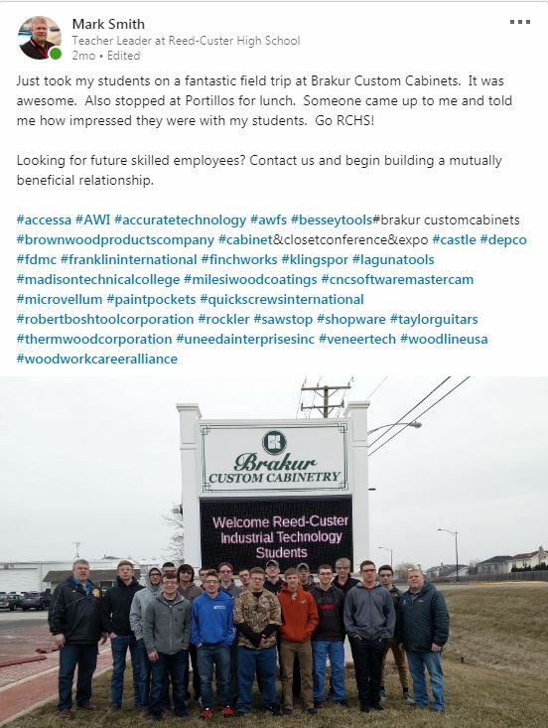
Free Marketing Tools-Press Release
How To Create a Press Release
Name of supporter
Logo of supporter
Hyperlink of supporter
Information about supporter
Image of student work
Image of donation
Image of donation being used
Hash Tags
Email account

Slide 17
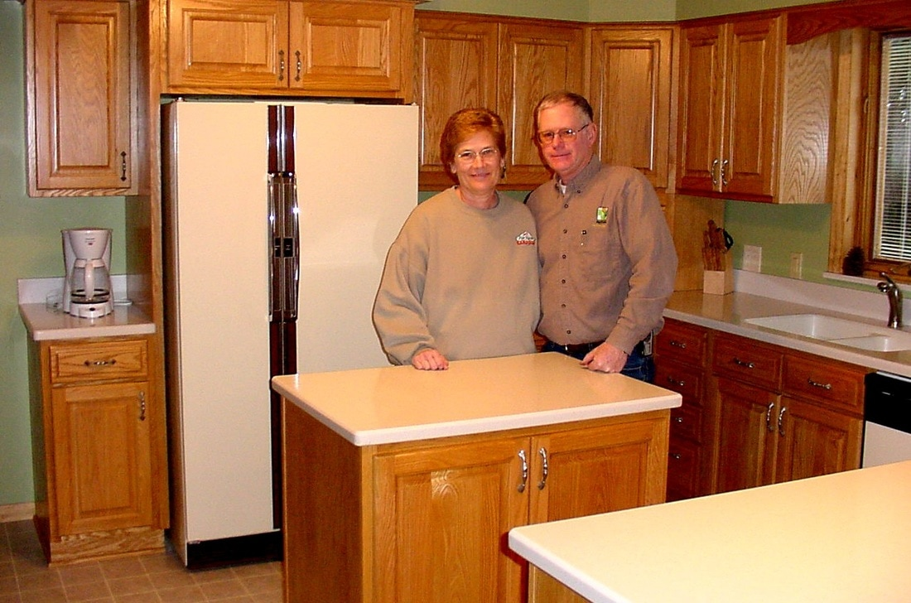
Create a LinkedIn Post
What should the post contain?
Image of students
Image of student work
What the image is about
Press-Release
Hash tags of supporters

Slide 18
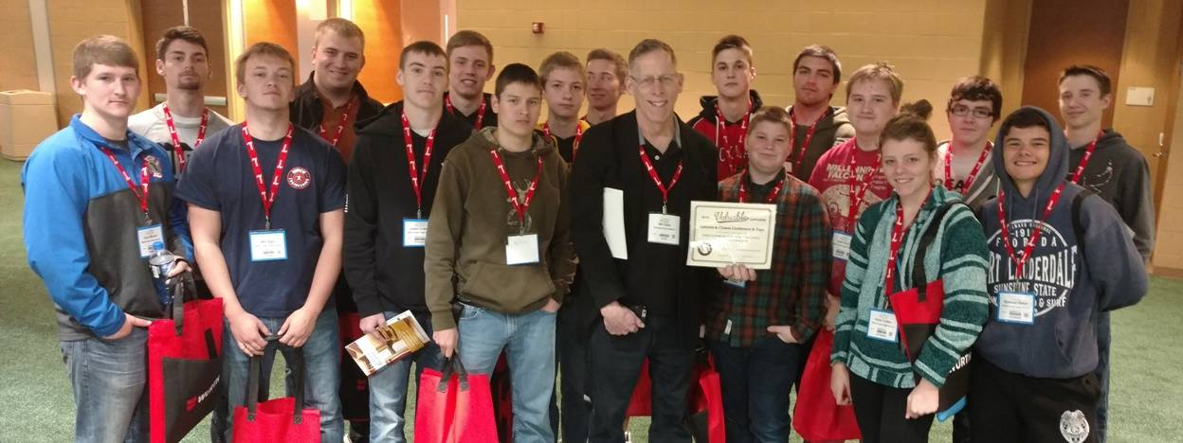
Marketing Tools-Always be Marketing
Market, Market, Market!
Market, Market, Market!
Market, Market, Market!
Market, Market, Market!
Market, Market, Market!
Market, Market, Market!

Slide 19
If You Want Access to Marketing Tools Send Me an Email Request.
marksmitheducate@gmail.com

